Slide 1

BAHC-19
Behavioral Analytics History of Covid-19

Slide 2
A. BAHC-19
Activity | CO2 levels | Mobility
Comparing the activity data’s | Tropospheric readings in Sentinel-5P | Activity Slowdown, Black Marble Data VIIRS
City of Nagoya, Beijing, Singapore | City of; Wuhan, Beijing | City of Beijing, and Singapore
Proposed graph of comparison data’s

Slide 3
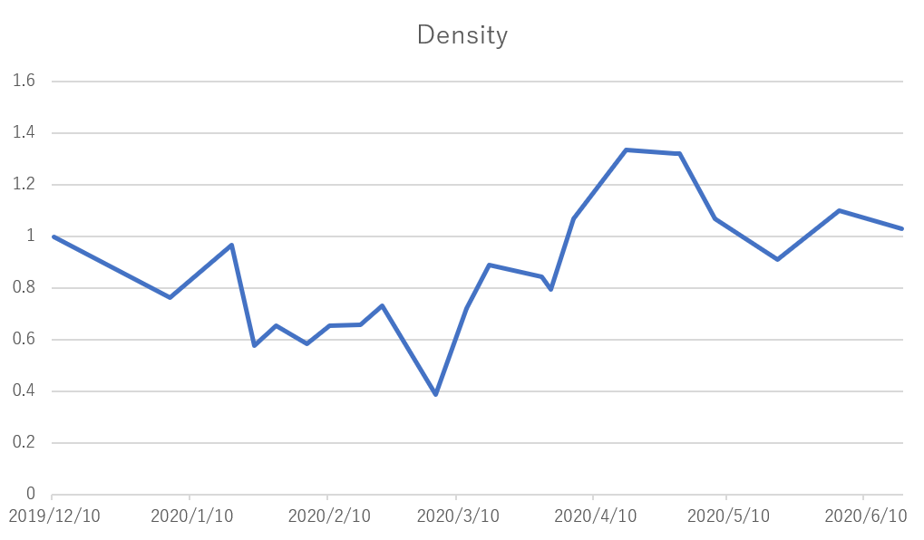
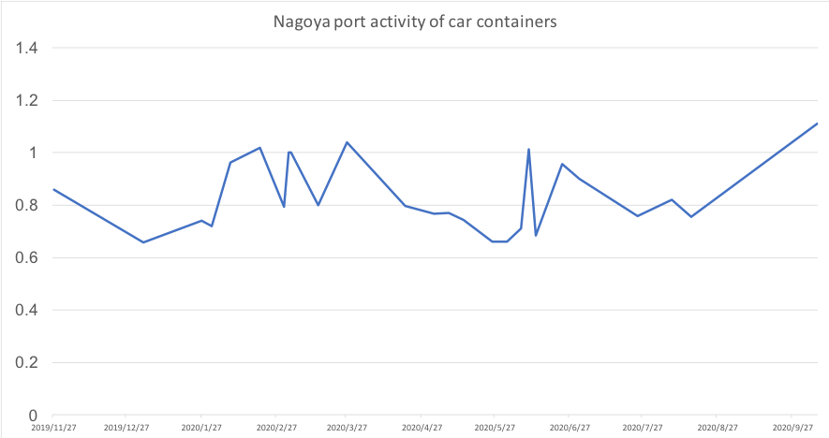
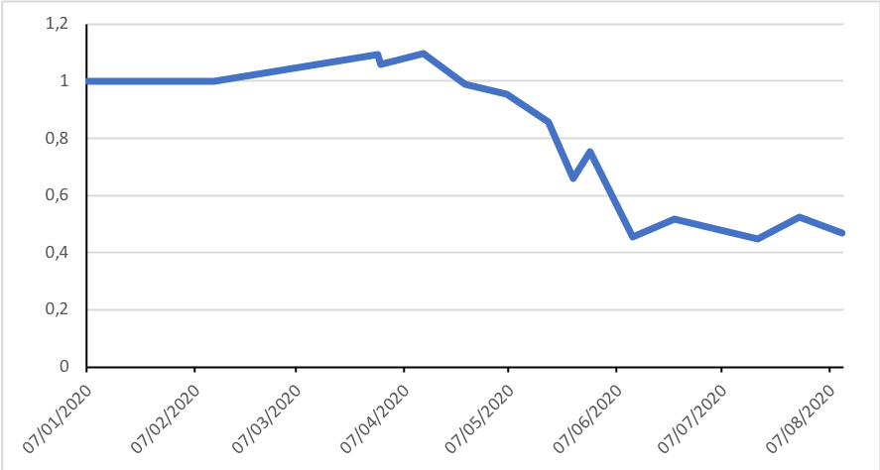
B. Data: Activity (car/cargo) Beijing, Singapore, Nagoya
Beijing
Nagoya
Singapore

Slide 4
C. Proposed new graph comparison for EO Dashboard.

Slide 5
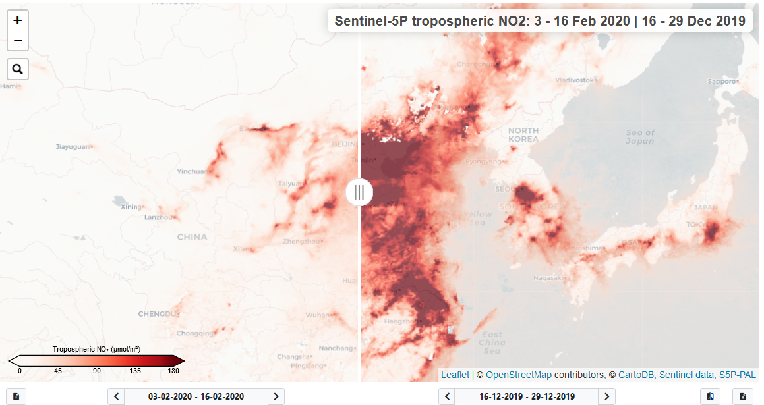
D. Tropospheric data slider. - A big change in human activity seen in NO2 levels.
China

Slide 6
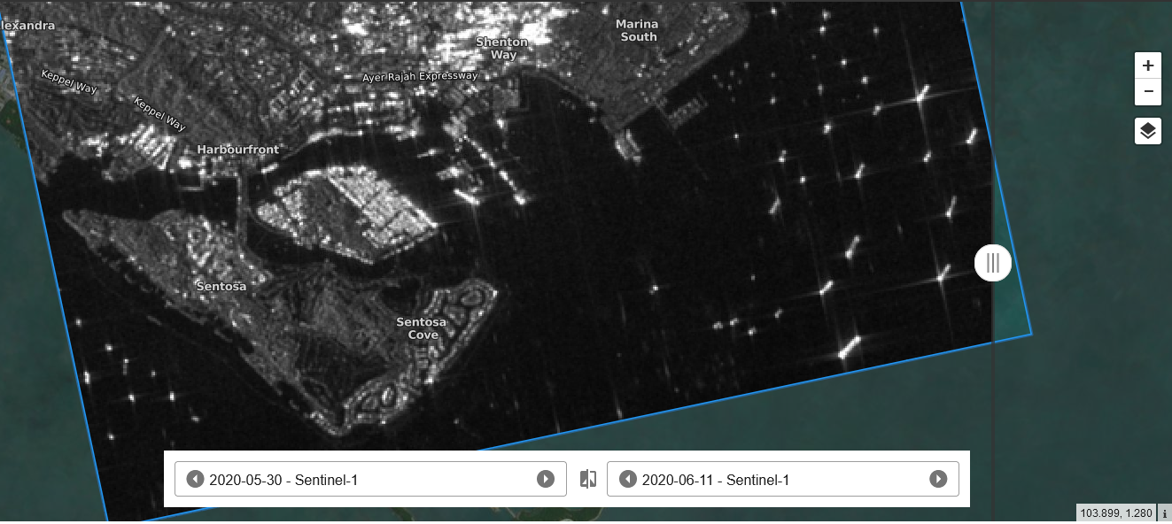
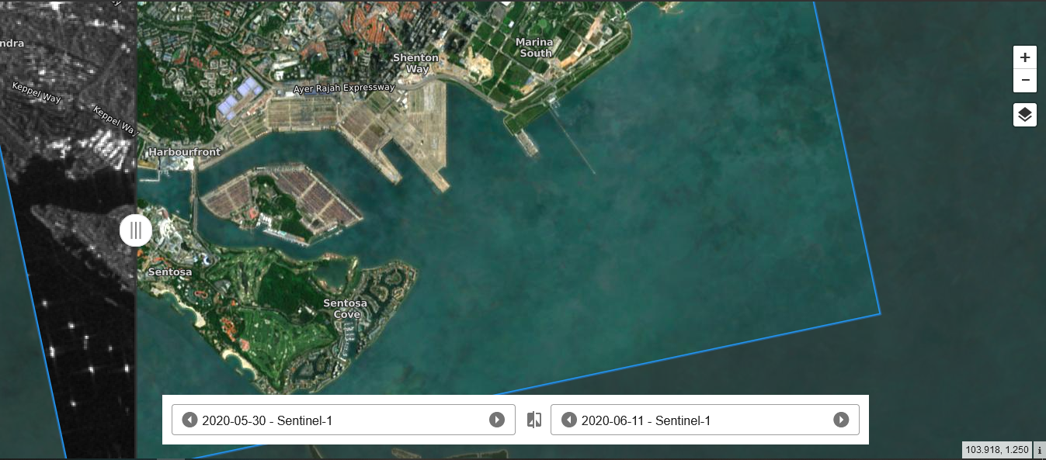
E. Nightlight and daylight activity anomaly.
Clearly you can see ships on the ocean on the Sentinel 1 Black Marble data.
Dated: 05-30-2020
City: Singapore
Just a month after on the same Sentinel 1 satellite map data but at daylight, the ships disappear.
Dated: 06-11-2020
City: Singapore

Slide 7
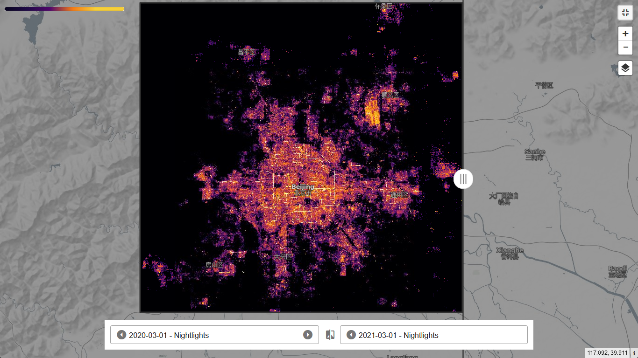
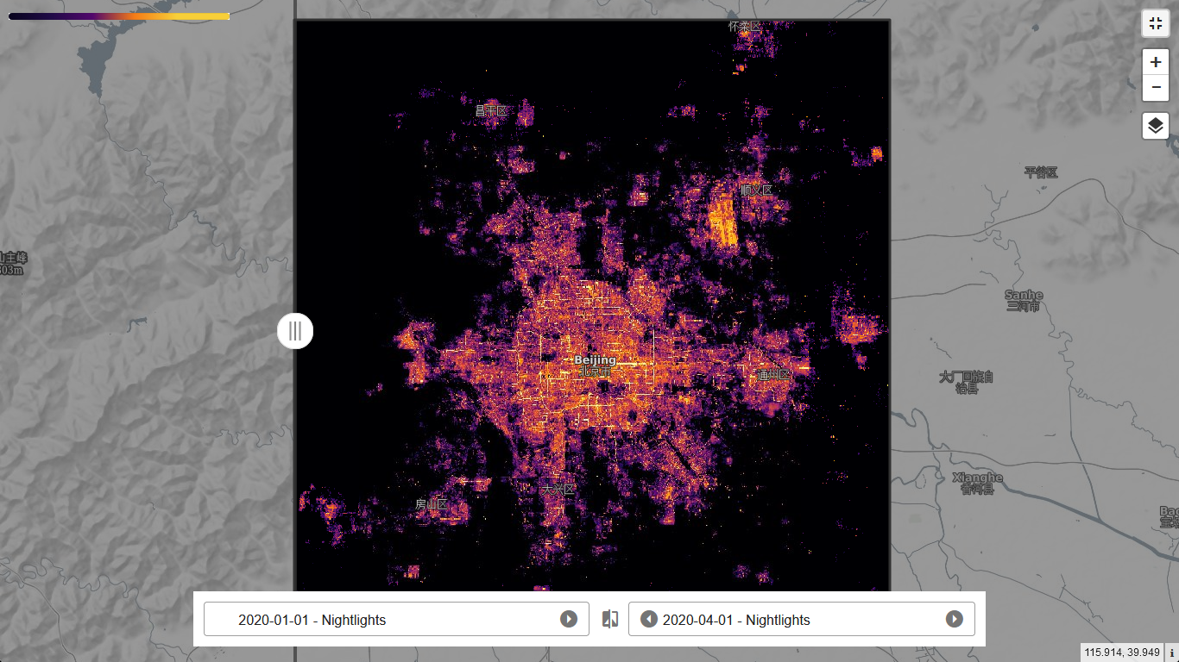
F. Black Marble Data in Beijing
March 2020 – reported that the government Announced to resume human activities by march 11.
April 2020 – The covid19 pandemic struck world-wide and Beijing went on a lockdown as light pollution are clearly lesser than the past month.

Slide 8
Thank you for reading!
Author: Ramdev G. Calope
Team: Dark

